Slide 1
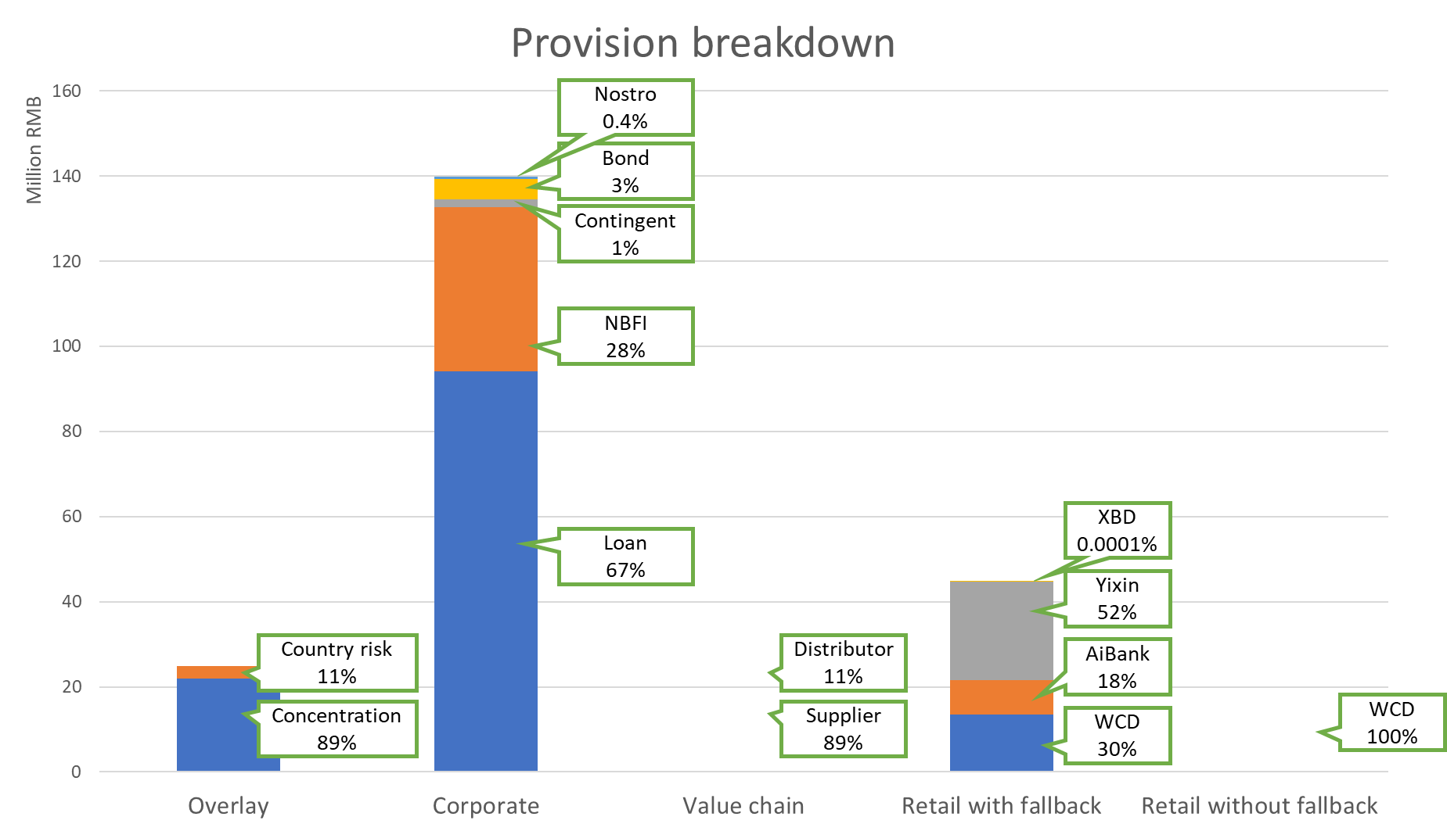
Overlay
Provision Breakdown
Segment | Outstanding | Provision | %Provision
Concentration | 708,000,000 | 13,510,000 | 1.91%
Country risk | 430,000,000 | 8,040,000 | 1.87%
Total | 1,897,070,000 | 44,700,060
Corporate
Provision Supply | Overlay | Corporate | Value Chain | Retail with Fallback | Retail without Fallback
209.52 | 24.86 | 134.45 |  | 44.7
Segment | Outstanding | Provision | %Provision
Loan | 4,722,000,000 | 94,080,000 | 1.99%
NBFI | 4,888,000,000 | 38,630,000 | 0.79%
Contingent | 404,000,000 | 1,740,000 | 0.43%
Bond | 3,579,000,000 | 4,870,000 | 0.14%
MM/Nostro | 757,000,000 | 620,000 | 0.08%
Total | 14,350,000,000 | 139,940,000
Value Chain
Segment | Outstanding | Provision | %Provision
Supplier | 708,000,000 | 13,510,000 | 1.91%
Distributor | 430,000,000 | 8,040,000 | 1.87%
Total | 1,897,070,000 | 44,700,060
Retail with Fallback
Segment | Outstanding | Provision | %Provision
WCD | 708,000,000 | 13,510,000 | 1.91%
Aibank | 430,000,000 | 8,040,000 | 1.87%
Yixin | 759,000,000 | 23,150,000 | 3.05%
XBD | 70,000 | 60 | 0.09%
Total | 1,897,070,000 | 44,700,060
Retail without Fallback
Segment | Outstanding | Provision | %Provision
WCD | 708,000,000 | 13,510,000 | 1.91%
Total | 1,897,070,000 | 44,700,060

Slide 3
Nostro
0.4%
Bond
3%
Contingent
1%
NBFI
28%
XBD
0.0001%
Loan
67%
Yixin
52%
Country risk
11%
Distributor
11%
AiBank
18%
Concentration
89%
Supplier
89%
WCD
30%
WCD
100%

